Slide 1
Lecture 3: C++ Programming

Slide 2
Outline
Typical C++ Development Environment
Integrated Development Environment
Structure of a C++ Program

Slide 3
Typical C++ Development Environment

Slide 4
Typical C++ Development Environment
Steps in creating and executing a C++ application
  Creating a Program
  Preprocessing
  Compiling
  Linking
  Loading
  Execution

Slide 5
Creating a Program
Type a C++ Program and save on some storage device
C++ source code filenames end with .cpp, .cxx or .C extensions

Slide 6
Preprocessing
Give the command to compile the program
In a C++ system, a preprocessor program executes automatically before the compiler translation begins.
Preprocessor executes directives which indicate certain manipulations to be performed before compilation

Slide 7
Compiling
Compiler translates the C++ source code into machine language(object code)

Slide 8
Linking
C++ programs may contain references to data and functions defined elsewhere. E.g. standard libraries, private libraries of groups of programmers working together.
A linker links the object code with the “missing” functions to produce an executable program.

Slide 9
Loading
Before a program can be executed, it must first be placed in memory.
This is done by the loader.
Loader takes the executable program from disk and transfers it to memory

Slide 10
Execution
The computer under the CPU executes the program one instruction at a time.

Slide 11
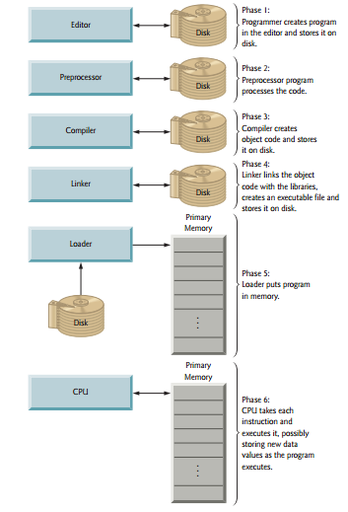
Steps in creating and executing a C++ Program

Slide 12
Integrated Development Environment

Slide 13
Integrated Development Environment
An integrated development environment is a software application that provides comprehensive facilities to computer programmers for software development.
An IDE normally consists of a source code editor, build automation tools and a debugger.
Examples: Dev-C++, Microsoft Visual Studio, Sublime, NetBeans, Eclipse, Spyder etc.

Slide 14
Structure of a C++ Program

Slide 15
Writing C++ Programs
Writing C++ programs is like writing an essay in English
How?
English essays have structure.

Slide 16
Example program: Program to output a line of text
//Hello World program in C++
#include "stdafx.h"
#include <iostream>
using namespace std;
int main()
{
cout<<"Hello World";
system("pause");
return 0;
}

Slide 17
//Hello World program in C++
This is a single line comment in C++.
A single line comment always begins with //
The // indicates that the remainder of each line is a comment
Comments are added to help other people read and understand your program
Comments can be used anywhere in the source code.

Slide 18
Multi line comments in C++
Multi-comments begin with /* and end with */
Multi line comments are used for comments containing many lines

Slide 19
#include <iostream>
Programming is carried out in add-on style. i.e. if something is already available you can use the same and develop further.
There are trillions of programs already developed by others. Why should we re-invent the wheel?

Slide 20
#include <iostream>
If we plan to use the readily available programs, we have to ask the compiler to include them.
Actual code will be available in machine language found in built in libraries

Slide 21
#
Lines beginning with a hash sign(#) are directives for the preprocessor.
This essentially means “read me before you compile” and do what I say
#include<iostream> therefore notifies the preprocessor to include in the program the contents the iostream library

Slide 22
#
General format for directives to the preprocessor is
  #include <name of the inbuilt library you want to include>
The < and > are just enclosures for the compiler to read between and import accordingly

Slide 23
#include <iostream>
This command therefore tells the compiler to include the iostream library
The iostream library must be included for any program that outputs data to the monitor or inputs data from the keyboard using C++’s stram input/output

Slide 24
using namespace std;
Namespaces are like drawers in a filing cabinet.
These drawers contain names/terms that we will use in writing our programs.

Slide 25
“using” directive
This directive tells the compiler that the subsequent code is making use of names in the specified namespace
using namespace std;
In this case the namespace is std
The std namespace includes C++ input/output names cout and cin

Slide 26
using namespace std;
The semicolon depicts the end of a statement
What is a statement?

Slide 27
Statements in C++
A programming statement is the smallest independent unit in a program, just like a sentence in the English language.
It performs a piece of programming action
A programming statement must be terminated by a semi-colon (;), just like an English sentence ends with a period.

Slide 28
Statements in C++
Why not end statements with a period like in English?
Because the period clashes with decimal point- it is hard for the computer to differentiate between a period and decimal point.

Slide 29
int main()
When a program begins running, the system calls the function main, which marks the entry point of the program.

Slide 30
int main()
This line initiates the declaration of a function. Essentially, a function is a group of code statements which are given a name.
In this case, this gives the name “main” to the group of code statements that follow.

Slide 31
int main()
Functions will be discussed in detail later, but essentially their definition is introduced with a succession of a type (int ), a name (main) and a pair of parentheses().

Slide 32
int main()
The function named main is a special function in all C++ programs.
It is the function that is called when the program is run.
The execution of all C++ programs begins with the main function regardless of where the function is actually located within the code.

Slide 33
cout
The standard output stream
Used to display output to the user
This name belongs to the namespace std

Slide 34
<<
Referred to as the stream insertion operator
The right operand’s characters normally print exactly as they appear between the double quotes.
cout<<"Hello World";
Why does this line end with a semi-colon?
What is the output of this code if run?

Slide 35
System (“pause”);
Used to freeze the console on the monitor

Slide 36
return 0;
Required to show that the function main completed successfully.

Slide 37
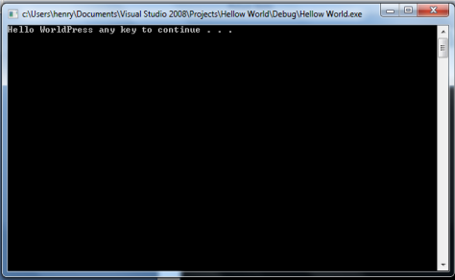
Output of our Hello World program

Slide 38
Class Exercise
Write a C++ program that will output the following statement:
  Happy New Year 2019
Write a C++ program that will request the user to enter his/her full name and greet them. E.g:
  Hello Alex Okama!!

Slide 39
Class Exercise
Write a program that will output the following statement:
  Welcome to the wonderful world of C++!!!

